Slide 1
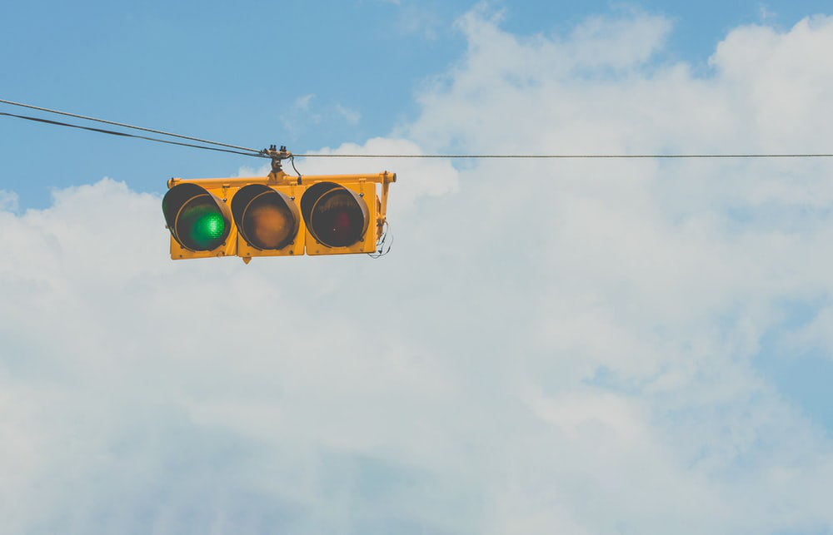

Traffic Lights System To Reduce Negative Impact Of Transport On Urban Environment

Slide 2
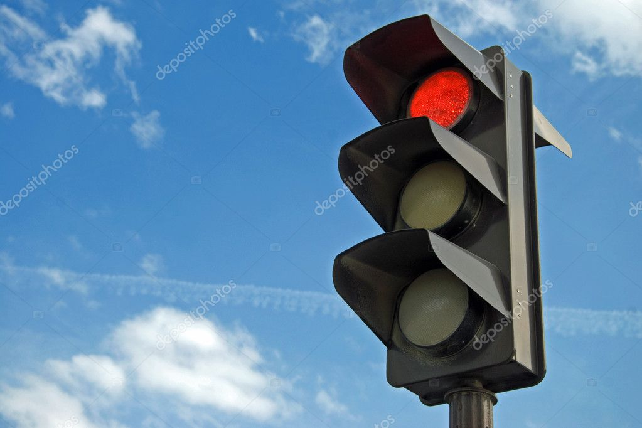
Traffic Lights System To Reduce Negative Impact Of Transport On Urban Environment
Submitted to:
Sir Kamran Shaheen
Submitted by:
Umar Hayyat(2019-EE-360)
Fatima Shafiq (2019-EE-362)
Aswa Arif(2019-EE-370)
Abdul Jabbar(2019-EE-376)
Muhammad Shaheed(2019-EE-408)
Ahmad Hafeez(2019-EE-432)

Slide 3
Traffic Lights System To Reduce Negative Impact Of Transport On Urban Environment
Contents
Introduction
Design Criteria
Aswa Arif
2019-EE-370

Slide 4
Traffic Lights System To Reduce Negative Impact Of Transport On Urban Environment
CONTENTS
1
Introduction
2
Background
3
Objectives
4
Review of literature
5
Materials
6
Working
7
Results
8
Conclusion
9
References

Slide 5
Introduction
Traffic Lights are used to control the vehicular traffic.
In the modern era, everyone has different types of vehicles resulting in rise to the numbers of vehicles.
That’s why traffic lights are mandatory to avoid the traffic jams and accidents.
Traffic light has proved to be an amazing way to stop the vehicular collisions and it also control the traffic jams in today’s modern era where everyone owns the different types of vehicles.

Slide 6
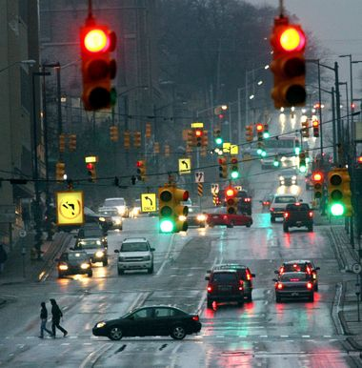
Introduction
Traffic signals are the most suitable method of controlling traffic in busy junction or lane.
The monitoring and controlling of Road/lane traffic is a major problem in many country.
Because Number of vehicles is increasing daily but highways developments have a lower phase that lead to traffic blocking problem or congestion problem.

Slide 7
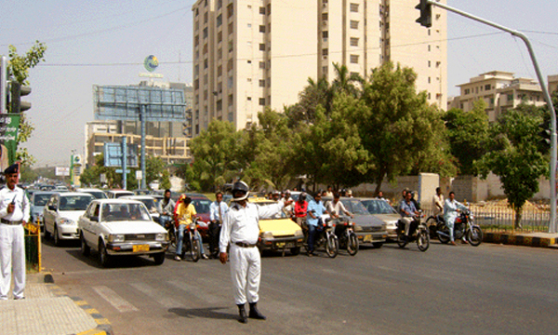
Introduction
Traffic policeman are stand at a traffic intersection daily in order to overcome these congestion in peak hour then one of the roots are a problem is due to unsuccessful traffic light controllers.

Slide 8
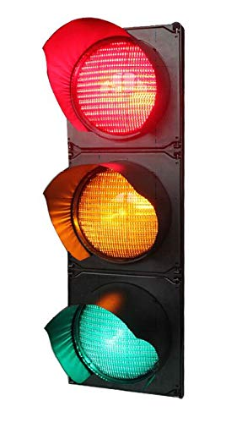
Introduction
There are three lights in the traffic signal, having different message for the drivers.
Red light (upper one) asks the driver to yield at the intersection.
Green light (last one) gives the driver free license to drive through the intersection.
The yellow light (middle one) alerts the driver to wait.
If the next light is red one or get ready to go / turn the engine ON if the green light is next.

Slide 9
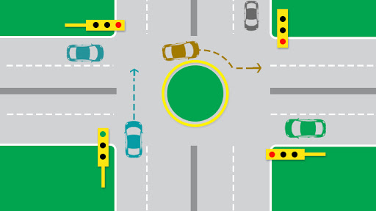
Introduction
Basic idea is that presentation we have chosen is a traffic light controller is to create four ways traffic controller through the concept of digital logic design.
That we create such a circuit in which there will be four traffic signals which will turn GREEN one by one while the other traffic signals are will be RED, simultaneously.

Slide 10
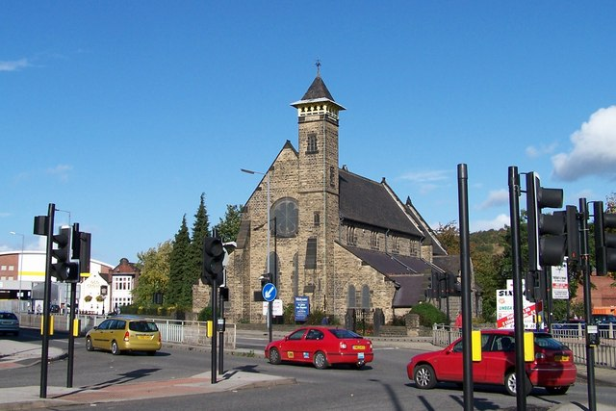
Introduction
Idea behind the design is to avoid accidents of vehicles by providing appropriate signals to different directions for a limited time slot, thus providing safety against collisions of vehicles.
After which the next waiting drivers will be given same treatment.

Slide 11
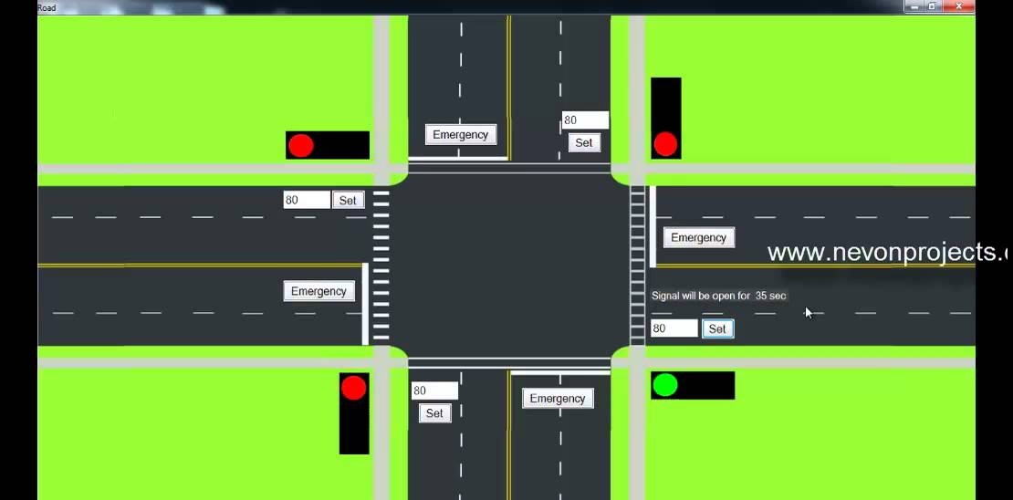
Introduction
The control signals are 3-lights.
Top light is Red, Middle light is Yellow , Bottom light is Green.
There are eight lanes and each lane will open one by one.
In this way 4 states are possible for which different vehicles will pass through the signals.

Slide 12
Design Criteria
In a traffic lights control system have a following assumptions are usable for designing.
Four way junction where traffic are coming on the four directions. These directions are a north and west and south and east.
Where traffic is moves from north and south direction then traffic are stop from west and east direction.
Left and right side turns are not considered.

Slide 13
Design Criteria
When East-west lane is assumed as the main approach or south-north lane is assumed as the main approach.
Maximum and minimum time for green light are determine Where traffic is moves from north and south direction then traffic are stop from west and east direction.

Slide 14
Traffic Lights System To Reduce Negative Impact Of Transport On Urban Environment
Background
Problems
Objectives
Fatima Shafiq
2019-EE-362

Slide 15
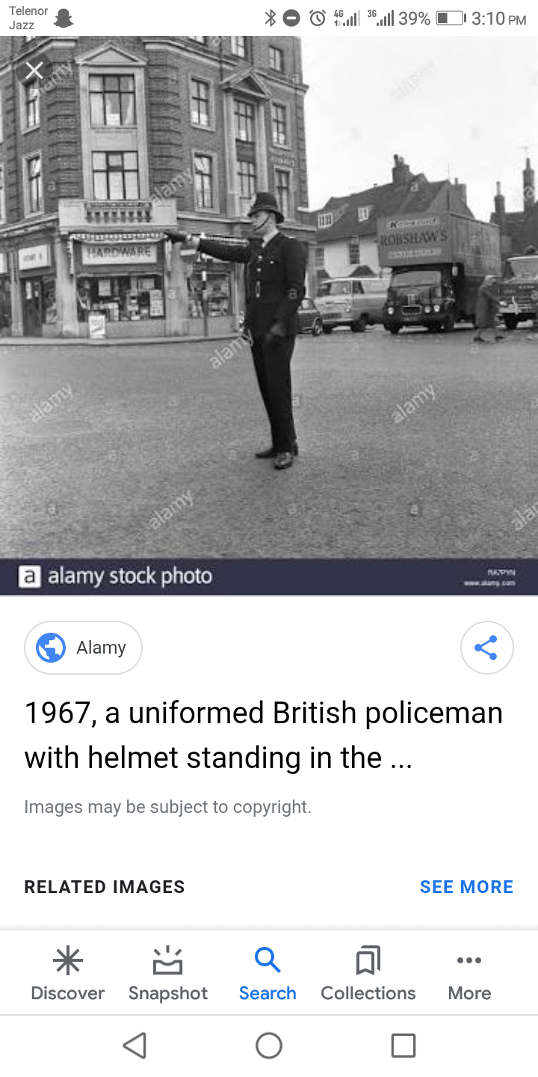
Background
..........Before 20th Century..........
Before traffic lights, traffic police controlled the flow of traffic.
A well-documented example is that on London Bridge in 1722.
Three men were given the task of directing traffic coming in and out of either London and Southwark.
On December 1868, the first non-electric gas-lit traffic lights were outside the Houses of Parliament in London.

Slide 16
Background
..........Before 20th Century..........
They were proposed by the railway engineer J.P Knight of Nottingham.
Although it was said to be successful at controlling traffic, its operational life was brief.
It exploded on 2 January 1869 as a result of a leak in one of gas lines underneath the pavement.
And it injured the policeman who was operating it.

Slide 17
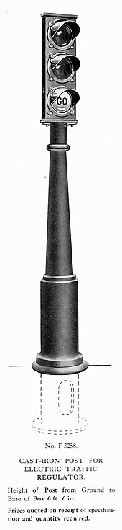
Background
..........20th Century..........
An electric traffic light was developed in 1912 by Lester Wire.
The first four-way, three-color traffic light was created by Police Officer William Potts in Detriot, Michigan in 1920.
The tower was the first innovation that used the three-colored traffic signal.
The man behind this three-color traffic light was police officer William Potts of Detroit.

Slide 18
Background
..........20th Century..........
Automatic control of interconnected traffic lights was introduced March 1922 in Houston, Texas.
In 1922, Traffic towers were beginning to be controlled by automatic timers.
The first company to add timers in traffic lights was Course Hinds.
The main advantage for the use of the timer was that it saved cities money by replacing traffic officers.
In 1949, the first traffic light in the continent of Asia was installed in Haifa, Israel.

Slide 19
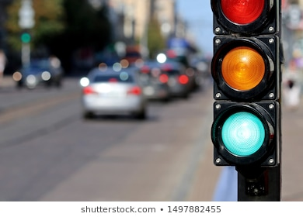
Background
..........20th Century..........
The control of traffic lights made a big turn with rise of computer in America in the 1950s.
In 1967,the city of Toronto was the first to use more advanced computers that were better at vehicle detection.
The computers maintained control over 159 signals in the cities through telephone lines.

Slide 20
Problems
Problems faced before traffic signals
Lot of accidents occur.
Traffic police control was much expensive.
Difficulty in traffic handling.
Control traffic is difficult in foggy weather or at night or on a rainy day.

Slide 21
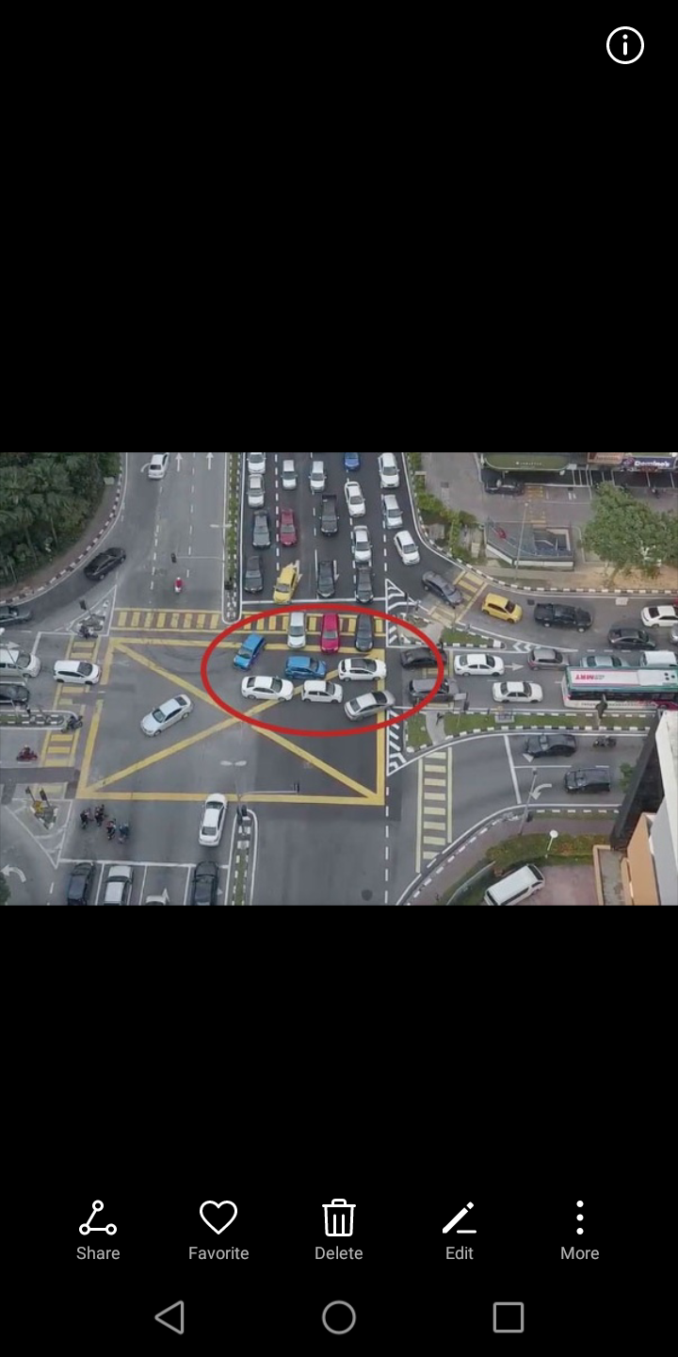

Slide 22
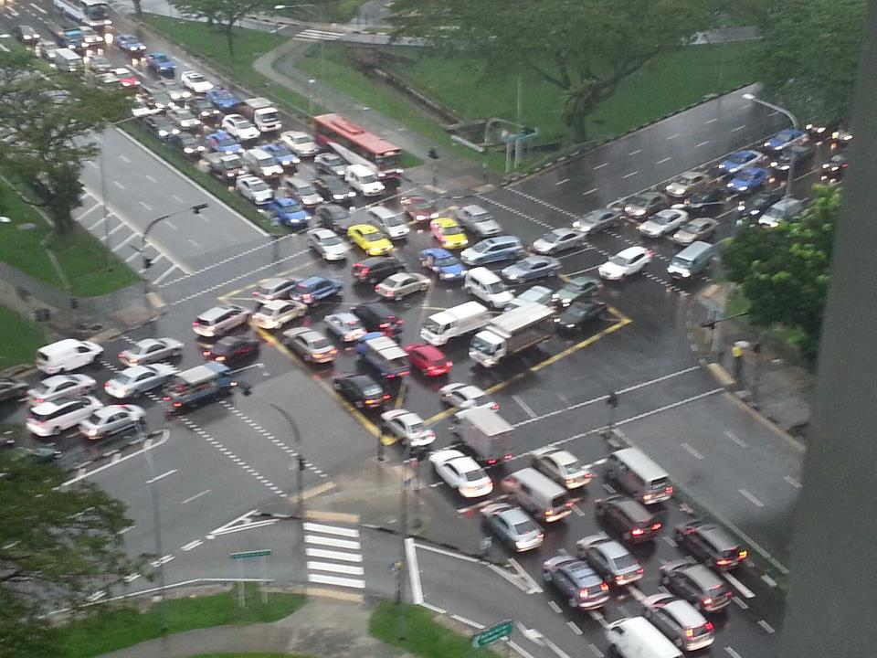
Problems
Lot of accidents occur:
Control traffic by traffic police is very difficult.
Traffic police control was much expensive:
It save cities money by replacing traffic officers.
The city of New york was able to reassign all but 500 of its 6000 officers working on the traffic squad.
This saved the city $12,500,000.

Slide 23
Problems
Difficulty in traffic handling:
Difficult to control the traffic in crowded places.
Control traffic is difficult in foggy weather or at night or on a rainy day:
In foggy weather or at night, its difficult to see the signs of traffic control officer.
Similarly, its very difficult for officers to stay on roads on a rainy day.

Slide 24
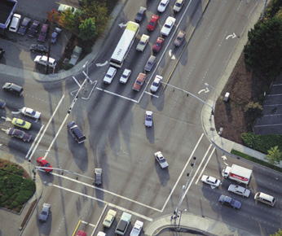
Objectives
The objective is:
to limit the stoppage time.
to regulate the traffic flow
to reducing the traffic jams in order to reduce traffic congestion.
to protect pedestrians and vehicles at busy intersections.
to reduce the severity and frequency of accidents.

Slide 25
Traffic Lights System To Reduce Negative Impact Of Transport On Urban Environment
Literature Review
Components
Abdul Jabbar
2019-EE-376

Slide 26

Literature Review

Slide 27
Components
Major components used for project are:
220/9v center taped transformer
1N4001 Diode
1000uF capacitor and 0.1uF capacitor (01)
470uF capacitor (2pcs)
0.01uF capacitor (3pcs)
7805 voltage regulator (01pcs)

Slide 28
Components
555 Timer IC (02pcs)
1C/O Relay(02 pcs)
BC 547 Transistor(02 pcs)
547 DC transistor
10k resisters (04pcs)
1k and 100k resisters (01)
15 w ,230V ,Dim light

Slide 29
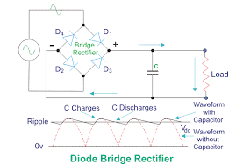
Compnents
..........Bridge Rectifier..........
A diode bridge is a arrangement of four diodes in a bridge circuit configuration that same polarity of output for either polarity of input.
It mostly used for conversion of Alternating current (AC) into Direct current (DC) ,is known as Bridge rectifier .
The essential feature of this arrangement is that it convert both cycle of Alternating current into Direct current
It also protect the circuit from (Reverse polarity) .

Slide 30
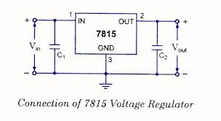
Components
Positive Voltage Regulator
7815 is a voltage regulator integrated circuit.
The voltage source in a circuit may have fluctuations and would not give the fixed voltage .
The regulator IC maintain the output at a constant level.
It provide 5V constant (DC ).
The main feature is that it protect circuit from overloading.

Slide 31
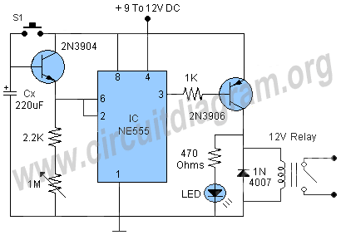
Components
The Timer IC(LM555)
The LM555 is a highly stable for generating accurate time delay or oscillation.
Additional terminals are provided for triggering and resetting if desired.
By this we can adjust time from micro seconds to hours.
It can be operate both in astableatate or monostablestate.
It has good temperature stability.

Slide 32
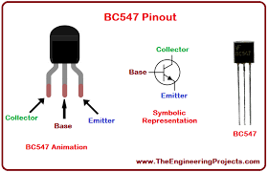
Components
Transistors
A BC547 transistor is a NPN transistor that is used for many purposes .
Togather with other components such as resisters ,coils and capacitor the BC547 can be used as active components for switches and amplifiers.
We used in our project as a switch.
In this we can adjust collector current by adjusting base current.

Slide 33
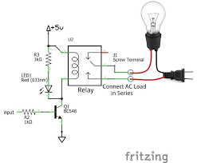
Components
TransistorsRelay(5V)
A relay consist of two separate and completely independent circuit. The first is at bottom and drive the electromagnet.
When the switch is on electromagnet is ON and it attract armature and armature acts as a switch for second circuit .
When the electromagnet is energized armature complete the circuit and light is ON and when electromagnet is not energized circuit is incomplete and light is OFF.

Slide 34
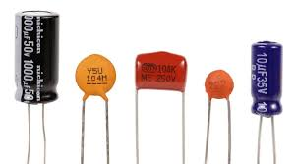
Components
Capacitor
Capacitor store electric charge . In this project they are with resister used as timing circuit because they take time to store charge.
We are also using capacitor to convert alternating current (AC) into smooth Direct current (DC).
We are also using capacitor as filter because capacitor allow alternating current and block Direct current.

Slide 35
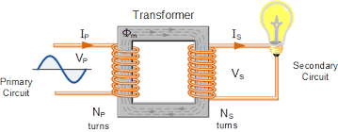
Components
Transformer
A transformer is an electrical device that transfer energy by inductive coupling between two or more of its windings .
Transformers are used for AC-to-AC conversion of single power frequency or for conversion of single power to a wide range of frequencies such as Audio or Radio frequencies.
Its main purpose in circuit is to step up or set down voltage.
We are using step down transfer in our circuit.

Slide 36
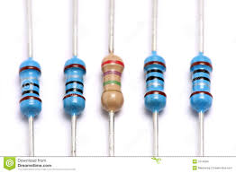
Components
Resistor
Resister is a passive two-terminal electrical component that implements electrical resistance as a circuit element .
In electrical circuit resisters are used to reduce current flow ,adjust signal level, to divide voltages , bais active element and terminate transmission lines among us.
Resister are two types fixed resisters and variable resisters .we are using fixed resister to reduce current flow.

Slide 37
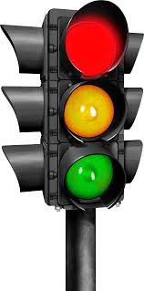
Components
LED Bulbs
LED blubs are electrical components that produce light.
Light emitting diode (LED) is two terminal electrical component which is used for emitting light.
Several LED are joined to make LED panel.
In traffic control system three LED panel used as a sign of GREEN ,AMBER and RED.

Slide 38

Traffic Lights System To Reduce Negative Impact Of Transport On Urban Environment
Working
Umar Hayyat
2019-EE-360

Slide 39
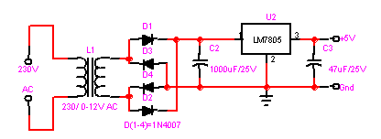
Working
The most common traffic lights work on simple timers.
Depending upon traffic levels at a particular intersection, the traffic light will cycle through green, yellow, and red at regular intervals.
It ensure a consistent flow of traffic in all directions through the intersection.

Slide 40
Working
The main power is stepped down by transformer to deliver a secondary output of 9v, 300 mA.
The transformer out put is rectified by a full-wave bridge rectifier comprising diodes D1 through D4.

Slide 41
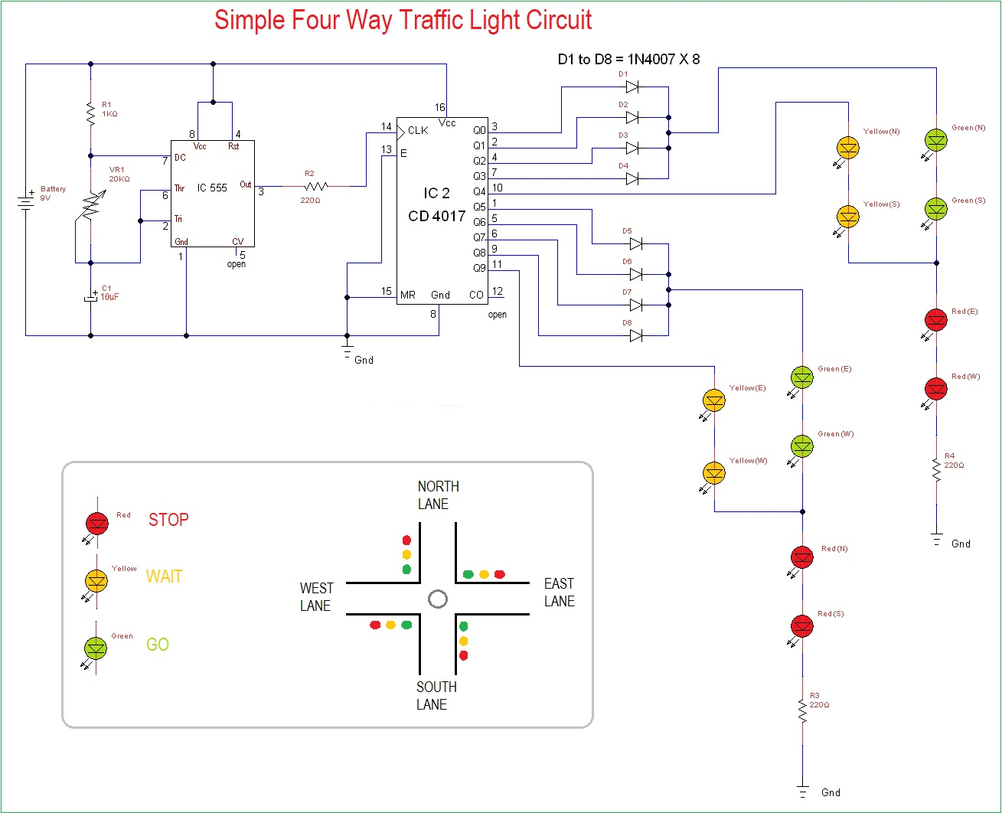

Slide 42
Working
Four way traffic light circuit diagram using 555 Timer IC is shown in diagram.
The timer generates pulses of time period 100ms approximately.
So the ON time is 50ms and OFF time is 50ms.
The time duration can be changed by changing the capacitor value.
The time shift for a four way traffic light can be achieved in this circuit by replacing the 10uF capacitor with a 470uF.

Slide 43
Working
Once the power is tune ON, the timer acts as a square wave generator and generates clock.
This clock is fed to the decade binary counter.
Now the decade binary counter counts the number of pulses given at the clock and lets the corresponding pin output go high.
If the event count is 3 then Q2 pin of counter will be high and if count is 5 then pin Q4 will be high.

Slide 44
Working
There will be a peak for every 100ms , with this peak the counter memory gains by one.
The diodes here prevent the shorting of counter outputs.
If the count is two with this the Q1 will be high (since Q1 is high all other outputs will be low including Q0, Q2).
Q1 with positive voltage gets hardly pulled down to LOW by Q0 as they are connected together.

Slide 45
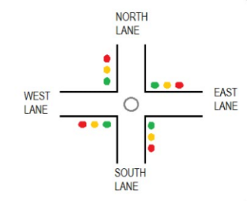
Working
During Q0, Q1, Q2, Q3 high the GREEN LED on NORTH and SOUTH will be ON along with RED LED on EAST and WEST.
If we assume clock is of 1Hz, the NORTH and SOUTH side are signaled GREEN to go for four sec and also the EAST and WEST side are signaled RED to STOP during this time.

Slide 46
Working
When Q4 goes high, the YELLOW LED on NORTH and SOUTH will be ON along with RED LED on EAST and WEST.
If we assume clock is of 1Hz, the NORTH and SOUTH side are signaled YELLOW to slow down for 1sec and also the EAST and WEST side are signaled RED to STOP during this time.

Slide 47
Working
When Q5, Q6, Q7, Q7 high the green LED on EAST and WEST will be ON along with red LED on NORTH and SOUTH.
If we assume clock is of 1Hz, the EAST and WEST side are signaled green to go for four sec.
And the NORTH and SOUTH side are signaled red to STOP during this time.

Slide 48
Working
When Q4 goes high, the yellow LED on EAST and WEST will be ON along with red LED on NORTH and SOUTH.
If we assume clock is of 1Hz, the EAST and WEST side are signaled yellow to slow down for 1sec and also the NORTH and SOUTH side are signaled red to STOP during this time.
These above four stages form a continuous cycle, to control the traffic light on a four way.

